Slide 1
PROJECT BASED LEARNING-1
GROUP-4
PROJECT-8

Slide 2
NORMALIZATION:
The data normalization is a basic element of data mining(data preprocessing).
It means transforming the data, namely converting the source data in to another format that allows processing data effectively.
The main purpose of data normalization is to minimize or even exclude duplicated data.
Normalization techniques are linear scaling, clipping log scaling, z-score and even more

Slide 3
REQUIRED PACKAGES
NUMPY
PANDAS
SKLEARN
MIN-MAX SCALER

Slide 4
STEPS NEED TO BE TAKEN:
Plot
Plot the dataset
Load
Load the dataset and print the first 5 rows
Prepare
Prepare data for normalization
Train
Train the normalization
Normalize
Normalize the dataset and print the first 5 rows

Slide 5
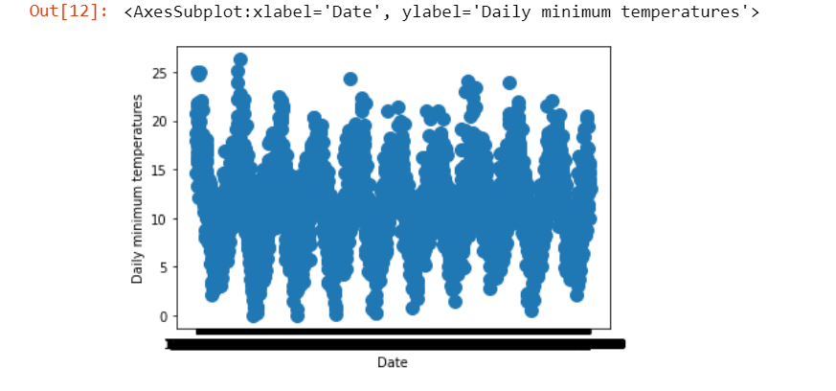
Plotting the Dataset:
data.plot.scatter(x='Date',y='Daily minimum temperatures',s=100)

Slide 6
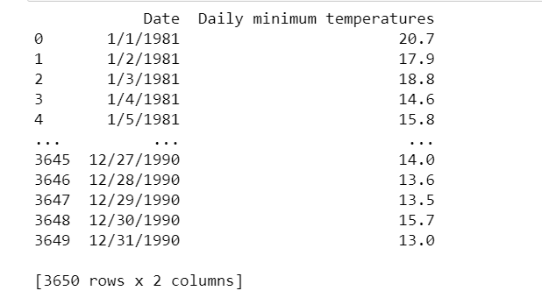
Loading the dataset:
import numpy as np
import pandas as pd
data=pd.read_csv("daily-minimum-temperatures.csv")
print(data)

Slide 7
Prepare data for normalization:
from sklearn import preprocessing
values= preprocessing.normalize(df)
print(values)

Slide 8
TraiNING THE NORMALIZATION:
series =pd.read_csv("daily-minimum-temperatures.csv", header=0, index_col=0)
values = series.values
values = values.reshape((len(values), 1))
scaler = MinMaxScaler(feature_range=(0, 1))
scaler = scaler.fit(values)
print('Min: %f, Max: %f' % (scaler.data_min_, scaler.data_max_))

Slide 9
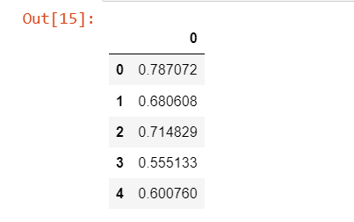
NORMALIZE AND PRINT FIRST 5 ROWS:
normalized = scaler.transform(values)
df1=pd.DataFrame(normalized)
df1.head()

Slide 10
Inference and analysis:
In this project we applied normalization techniques on the dataset.
Some normalization techniques are zscore, min-max scaling, decimal scaling, etc…
Here, in this project I have applied min-max scaling which results in scaled data values.

Slide 11


